Slide 1
Chapter 12 – Controlled Release Strategies in Tissue Engineering

Slide 2
Notes:
Figure 12.1: Engineering controlled release to increase therapeutic window.

Slide 3
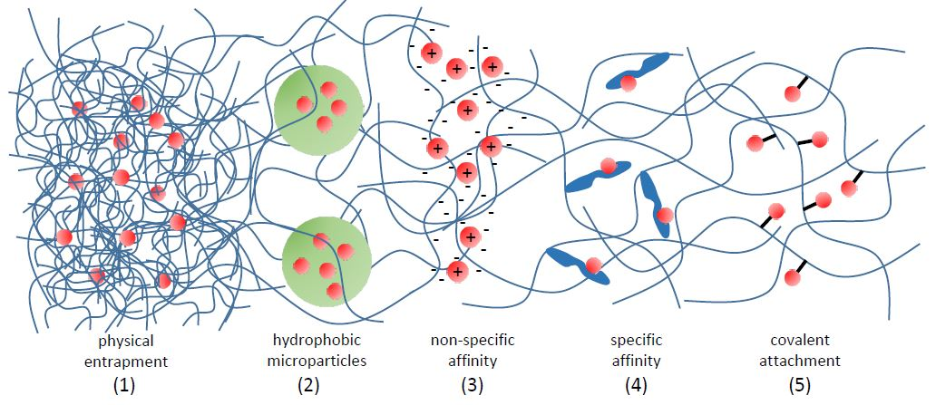
Notes:
Figure 12.2: Depiction of controlled release strategies in tissue engineering.

Slide 4
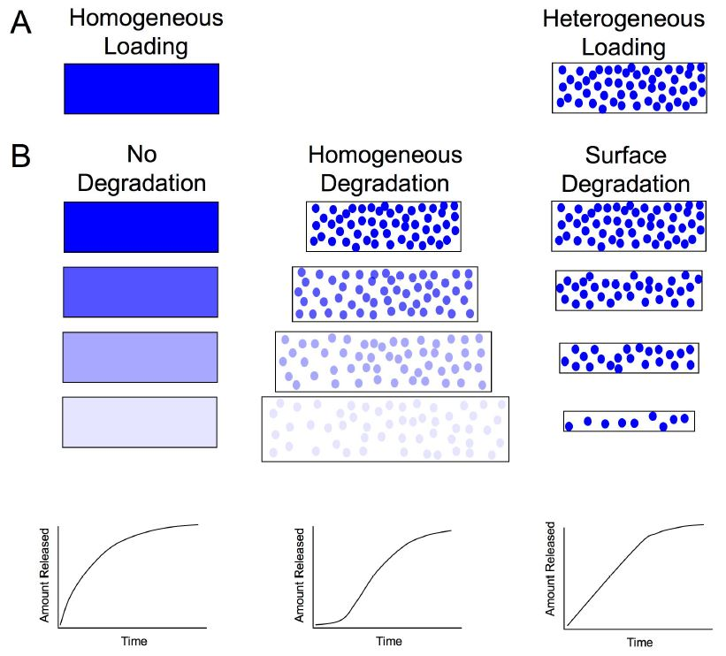
Notes:
Figure 12.3: Time release profiles of homogeneous and heterogeneous drug loading in matrices.

Slide 5
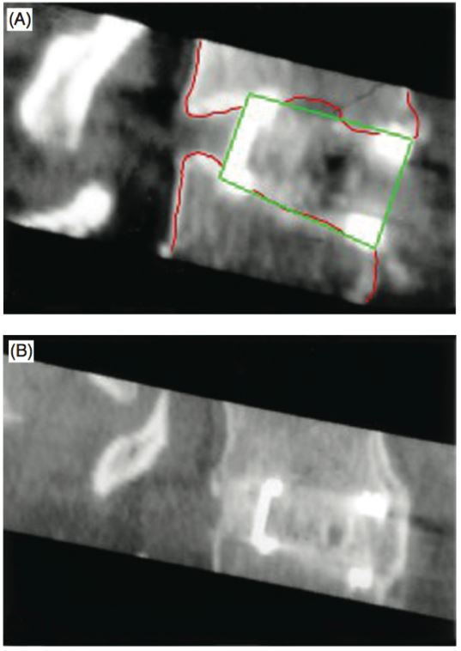
Notes:
Figure 12.4: Radiographic image of vertebrae treated with a spinal fusion cage filled with bmp-2.
From Radiographic assessment of interbody fusion using recombinant human bone morphogenetic protein type 2, Burkus, Dorchak and Sanders, 2003, Spine 28 372–377.

Slide 6
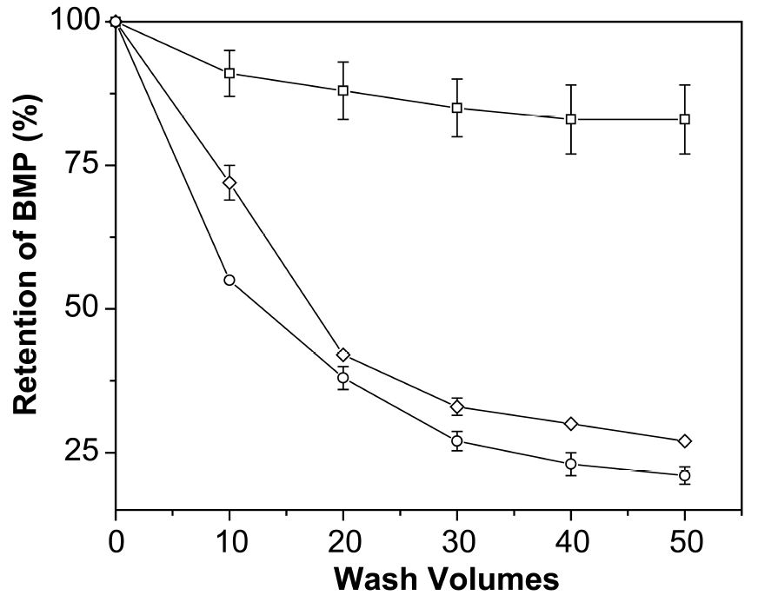
Notes:
Figure 12.5: Retention profile of glycosylated and nonglycosylated bmp-2 from fibrin with and without heparin.
From Bone healing in the rat and dog with nonglycosylated BMP-2 demonstrating low solubility in fibrin matrices, Schmoekel et al., 2004, J. Orthop. Res. 22 376–381.

Slide 7
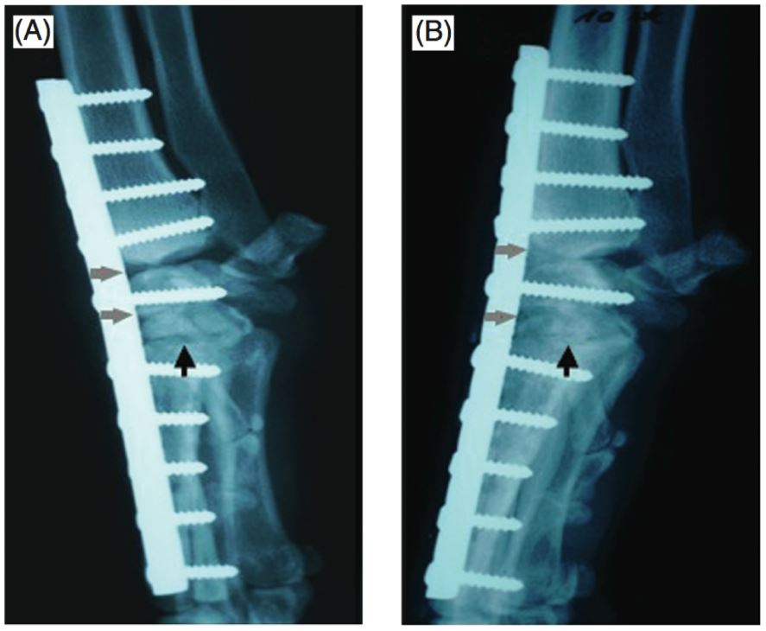
Notes:
Figure 12.6: Nonglycosylated bmp-2 used in fibrin surgical matrices to fuse the carpal joint complex in canine patients in pancarpal arthrodesis procedures.
From Bone healing in the rat and dog with nonglycosylated BMP-2 demonstrating low solubility in fibrin matrices, Schmoekel et al., 2004, J. Orthop. Res. 22 376–381.

Slide 8
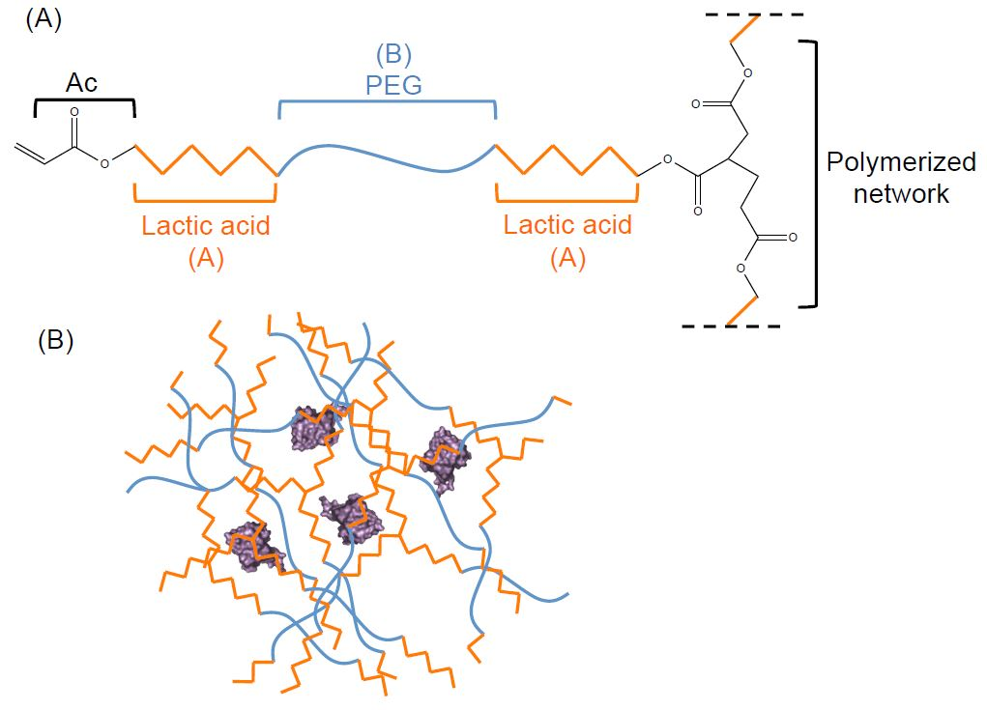
Notes:
Figure 12.7: Formation of hydrolytically sensitive peg hydrogel networks.

Slide 9
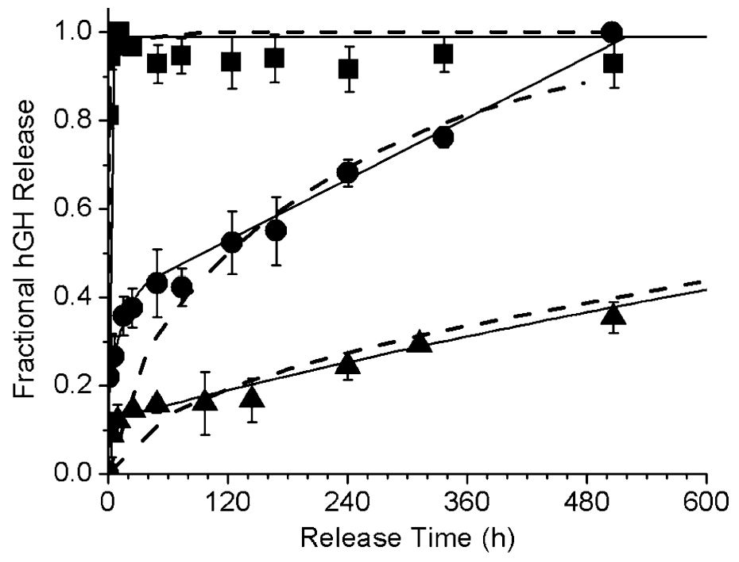
Notes:
Figure 12.8: Controlled release via the network architecture of crosslinked peg hydrogels.
From Poly(ethylene glycol) hydrogels formed by conjugate addition with controllable swelling, degradation, and release of pharmaceutically active proteins, van de Wetering et al., 2005, J. Control. Release 102 619–627.

Slide 10
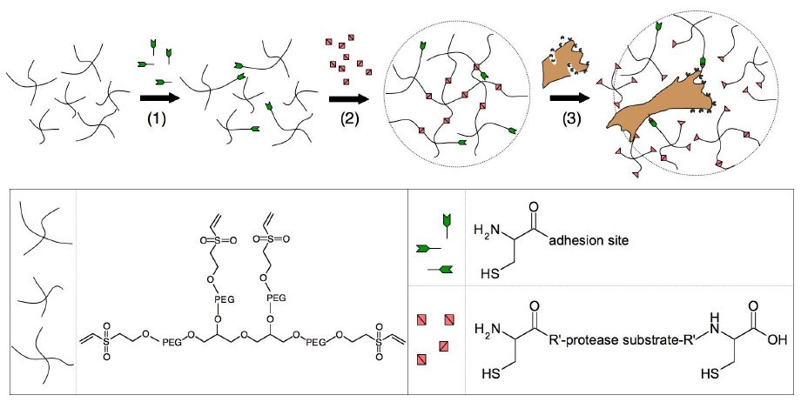
Notes:
Figure 12.9: Design of biomimetic gel matrices degradable by migrating cells.
From Cell-responsive synthetic hydrogels, Lutolf et al., 2003, Adv. Mater. 15 888–892.

Slide 11
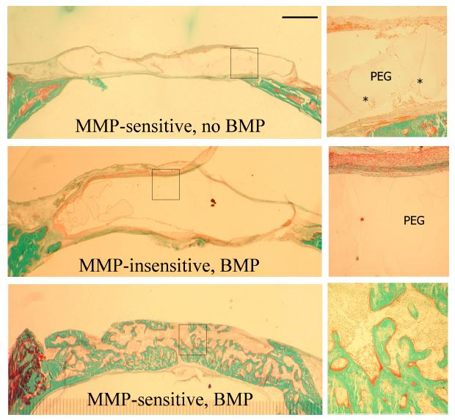
Notes:
Figure 12.10: Bone healing of critical-size rat calvaria defects with MMP-sensitive and adhesive PEG gels containing BMP.
From Repair of bone defects using synthetic mimetics of collagenous extracellular matrices, Lutolf et al., 2003, Nat. Biotechnol. 21 513–518.

Slide 12
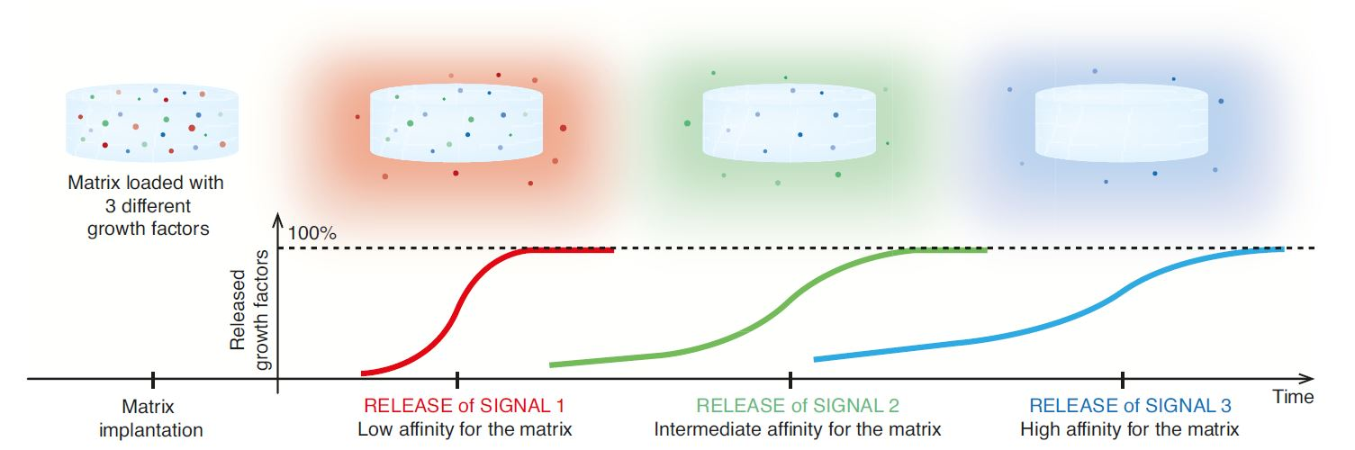
Notes:
Figure 12.11: Variable release profiles for improved tissue regeneration.
From Engineering the regenerative microenvironment with biomaterials, Rice et al., 2013, Advanced healthcare materials, 2, 57-71.

Slide 13
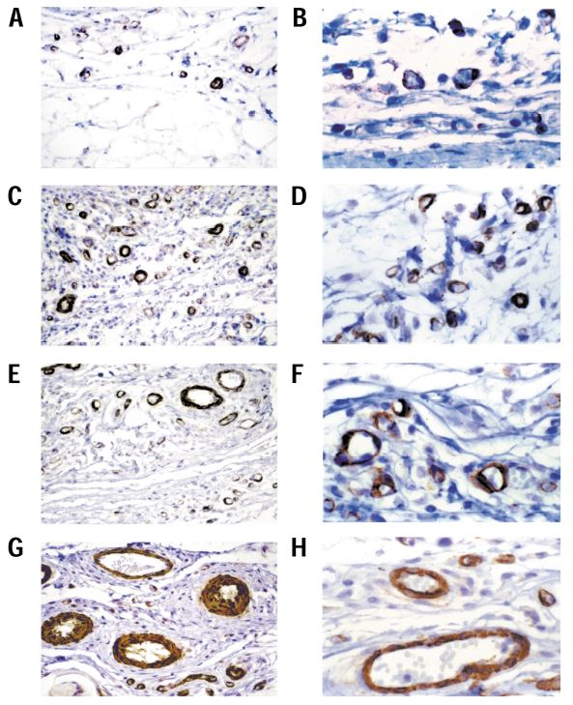
Notes:
Figure 12.12: Enhanced angiogenesis using dual growth factor (VEGF and PDGF) release systems.
From Polymeric system for dual growth factor delivery, Richardson et al., 2001, Nature Biotechnol., 19, 1029-1034.

Slide 14
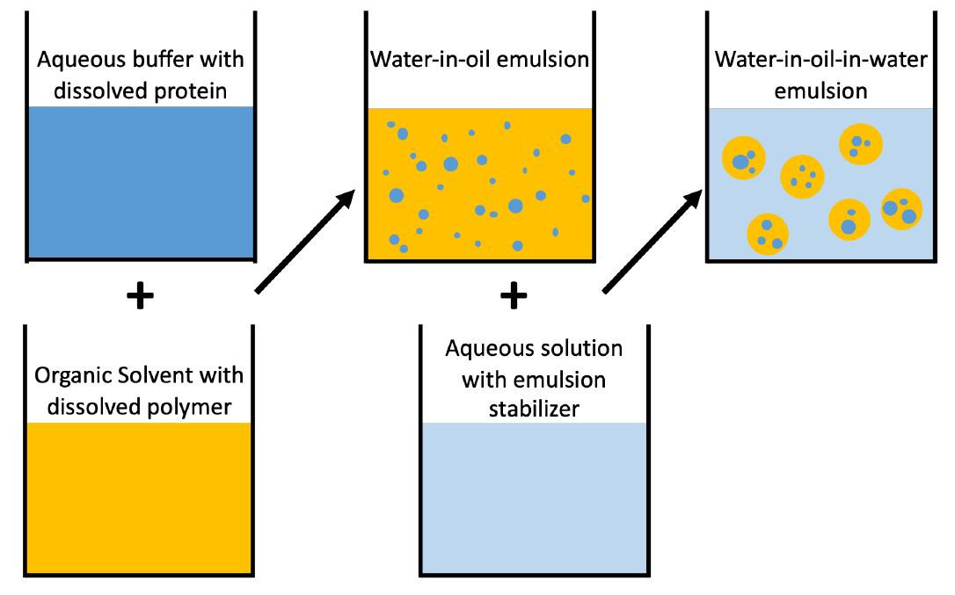
Notes:
Figure 12.13: Water-in-oil-in water double emulsion to generate polymer microparticles containing protein drugs.

Slide 15
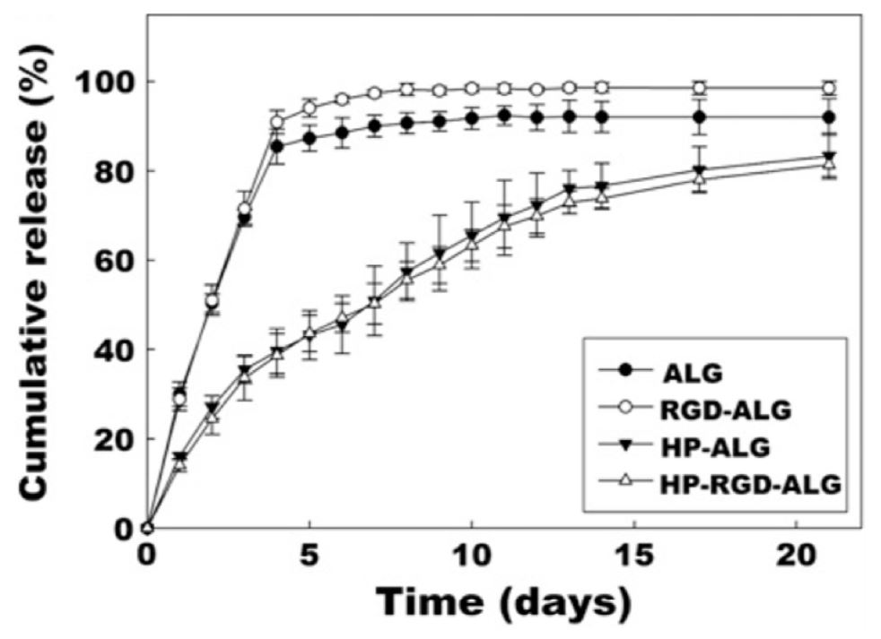
Notes:
Figure 12.14: Heparin functionalized alginate for control release of VEGF.
From Affinity-based growth factor delivery using biodegradable, photocrosslinked heparin–alginate hydrogels Jeon et al., 2011, J. Control. Release 154 258–266.

Slide 16
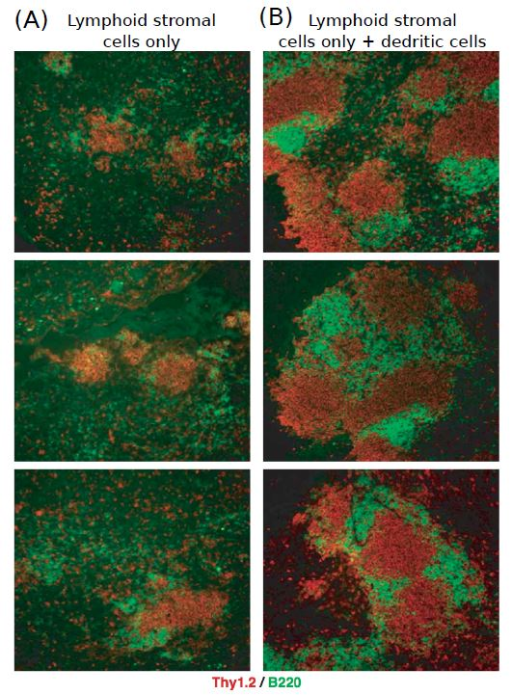
Notes:
Figure 12.15: Inclusion of activated dendritic cells (DCS) in collagenous scaffold.
From Generation of a synthetic lymphoid tissue-like organoid in mice, Suematsu and Watanabe, 2004, Nat. Biotechnol. 22 1539–1545.

Slide 17
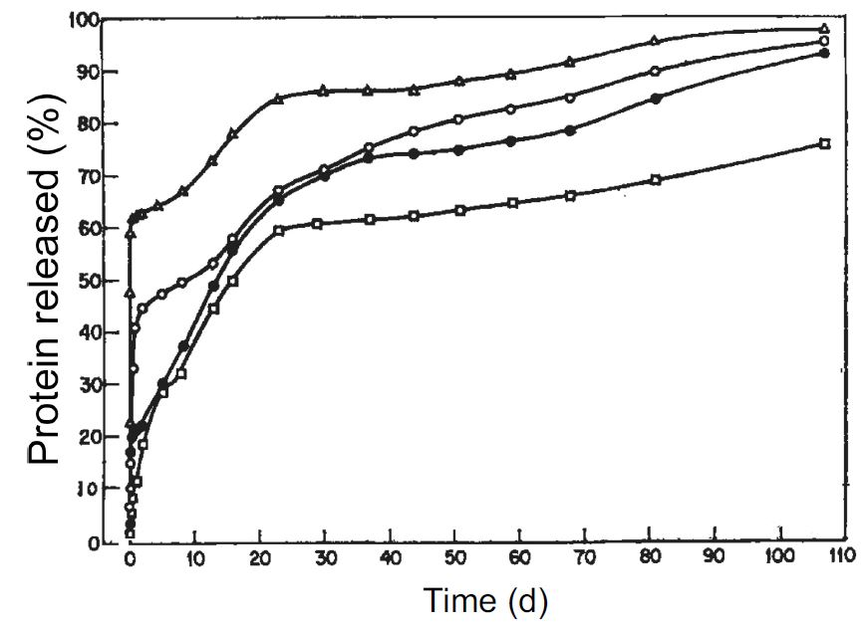
Notes:
Figure 12.16: The cumulative protein release over time, as demonstrated first by Langer and Folkman.
From Polymers for Sustained-Release of Proteins and Other Macromolecules, Langer, R. & Folkman, J. 1976Nature, 263, 797-800.

Slide 18
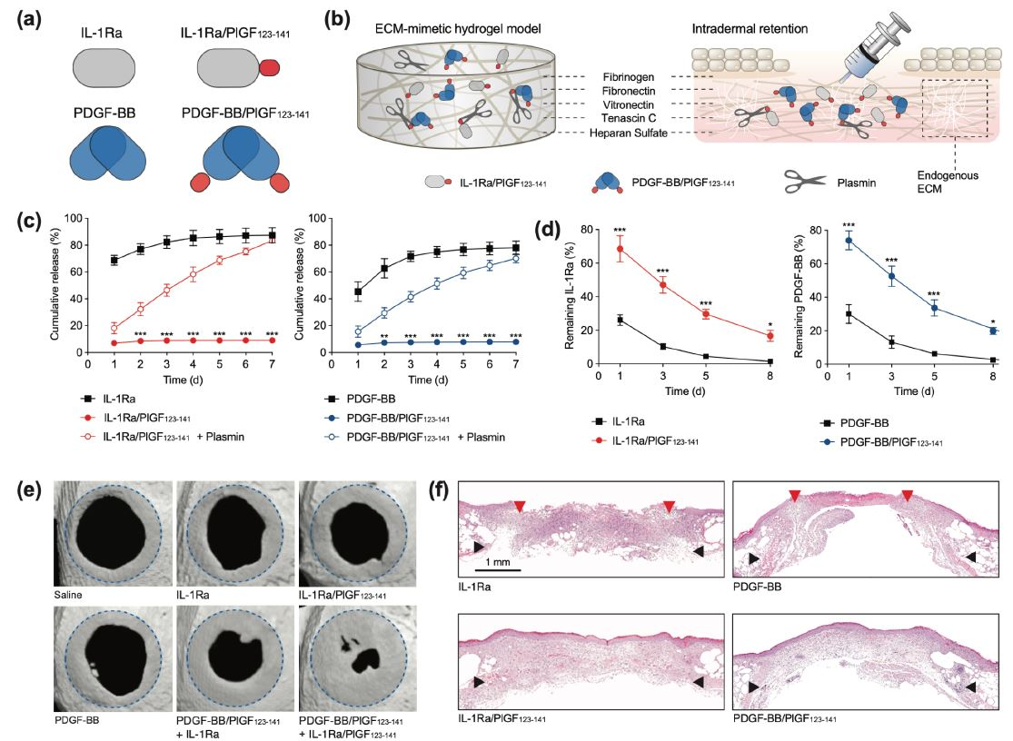
Notes:
Figure 12.17: Important steps to tissue restoration in diabetic wounds using IL-1 receptor antagonist.
From Restoration of the healing microenvironment in diabetic wounds with matrix-binding IL-1 receptor antagonist, Tan, J.L., et al., 2021. Communications biology, 4(1), pp.1-11.

